Slide 1



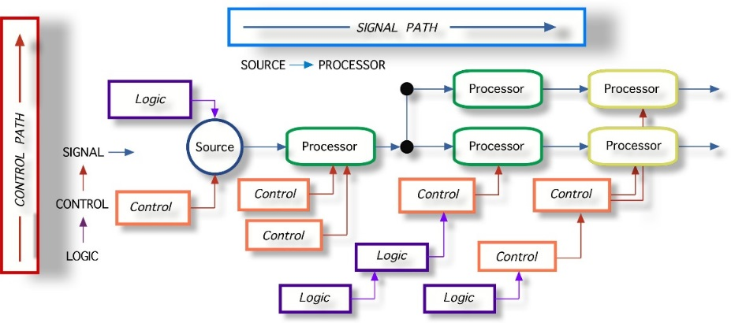
AMD and RequireJS
Splitting JavaScript Code into Dependent Modules
SoftUni Team
Technical Trainers
Software University
http://softuni.bg

Slide 2
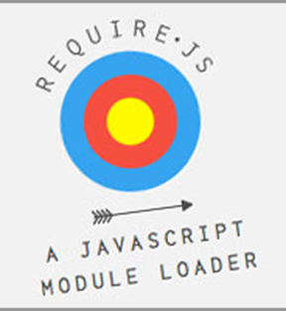
Table of Contents
AMD Overview
RequireJS Overview
Installation and Configuration
Defining Modules with RequireJS
Defining Dependent Modules

Slide 3
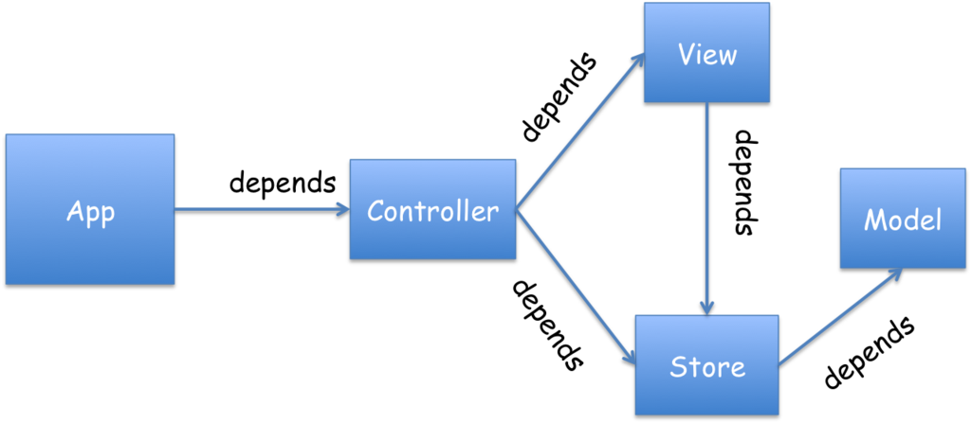
AMD Overview
depends
depends
depends
depends
depends
The Missing Client-Side JS Module System

Slide 4
AMD Overview
Asynchronous module definition (AMD) is a JavaScript API for defining modules
Modules (JS files) are loaded asynchronously
Useful in improving the performance of websites
AMD allows to create dependent modules
Modules that need other modules to work
RequireJS is a famous AMD library
Runs both in the browser and in Node.js

Slide 5

Dive into RequireJS
How to Create Dependent Modules?

Slide 6
RequireJS Overview
RequireJS is a JavaScript file and module loader
Optimized for in-browser use
Can be used in other JavaScript environments
Like Rhino and Node.js
Modular loaders improve the speed and quality of code
Inspire lazy-loading of JS files
Makes files dependent on other files

Slide 7
RequireJS Overview (2)
Using RequireJS makes code more simpler and optimized
Load JavaScript files only when needed
Handles the "many-scripts-hell" in a Web page
Load a single file/module (app.js)
Main file will require other files/modules
And these other modules will require more modules and etc.

Slide 8
Using RequireJS
Step by Step Guidelines

Slide 9
Using RequireJS
RequireJS needs a configuration file to load other files
The config file is the single JavaScript file in the web page
RequireJS loads all code relative to a base url
The url given in data-main attribute
RequireJS assumes by default that all dependencies are scripts
Suffix ".js" is not expected

Slide 10
Using RequireJS: Steps
How to use RequireJS?
Fetch the require.js file:
Download it from RequireJS web site
Install with bower:
Create an app.js file to start your application
Create an HTML page and include RequireJS library
Set the src attribute to the require.js library
Set the data-main attribute to the app.js file
$ bower install requirejs
<script src="scripts/libs/require.js" data-main="scripts/app/app"></script>

Slide 11
RequireJS Configurations
baseUrl – the root path to use for all module lookups
The default value is the location of the HTML page that loads require.js
If data-main attribute is used, the path will become the baseUrl
paths – mapping module names to paths relative to baseUrl
(function () {
require.config({
baseUrl: "/another/path",
paths: {
"jquery": "libs/jquery-2.0.3",
"angular": "libs/angular-1.3.min"
}
});
});

Slide 12
The app.js File
The app.js is the file, that starts your application
It has dependencies to other RequreJS modules
(function () {
require.config({
paths: {
"jquery": "libs/jquery-2.0.3"
}
});
});
require(["jquery"], function () {
//write your jQuery-dependent code here
});
}());

Slide 13

Using RequireJS
Live Demo

Slide 14

Defining Modules in RequireJS

Slide 15
Modules
A module is a well-scoped object that avoids polluting the global scope
It can explicitly list its dependencies and get a handle on those dependencies
Dependencies are received as arguments to the define function
The RequireJS module is an extension of the Module Pattern

Slide 16
Modules (2)
The RequireJS syntax for modules allows them to be loaded as fast as possible
Evaluated in the correct dependency order
Since global variables are not created it is possible to load multiple versions of a module
There should have only one module definition in a single JS file!
The modules can be grouped into optimized bundles

Slide 17
Defining Modules
Defining modules is done using the define function of RequireJS:
The name of the modules is the path of the file
Not all modules need dependencies
If no dependencies, just pass a function handler / object
// file "libs/module1.js"
define(function(){
// do stuff
return result; }
define({ properties });

Slide 18
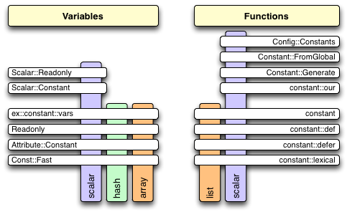
Defining Simple Modules
Live Demo

Slide 19
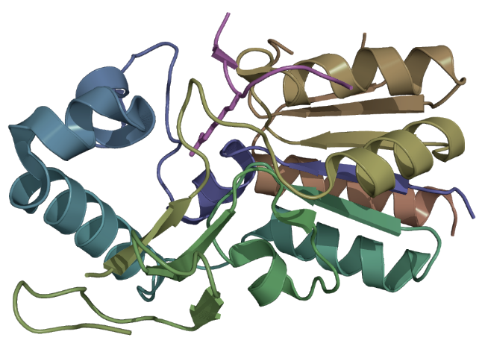
Defining Modules with Dependencies

Slide 20
Defining Dependencies
Some modules use another modules
RequireJS can "request" a file to be loaded
Pass the names of the required module as an array in the define function
If any of them is not loaded, RequireJS will load it
Load dependencies in order of define
Second argument is angular
Second argument is angular
// file "libs/module1.js"
define(['jquery', 'angular'], function($, ng) {
$('#button').on('click', function() { … });
return result; }
First argument is jquery
First argument will be jquery

Slide 21
Defining Dependencies
Live Demo

Slide 22







AMD and RequireJS
https://softuni.bg/courses/javascript-oop/

Slide 23
License
This course (slides, examples, demos, videos, homework, etc.) is licensed under the "Creative Commons Attribution-NonCommercial-ShareAlike 4.0 International" license
Attribution: this work may contain portions from
“JavaScript Basics" course by Telerik Academy under CC-BY-NC-SA license

Slide 24





Free Trainings @ Software University
Software University Foundation – softuni.org
Software University – High-Quality Education, Profession and Job for Software Developers
softuni.bg
Software University @ Facebook
facebook.com/SoftwareUniversity
Software University @ YouTube
youtube.com/SoftwareUniversity
Software University Forums – forum.softuni.bg

